Slide 1
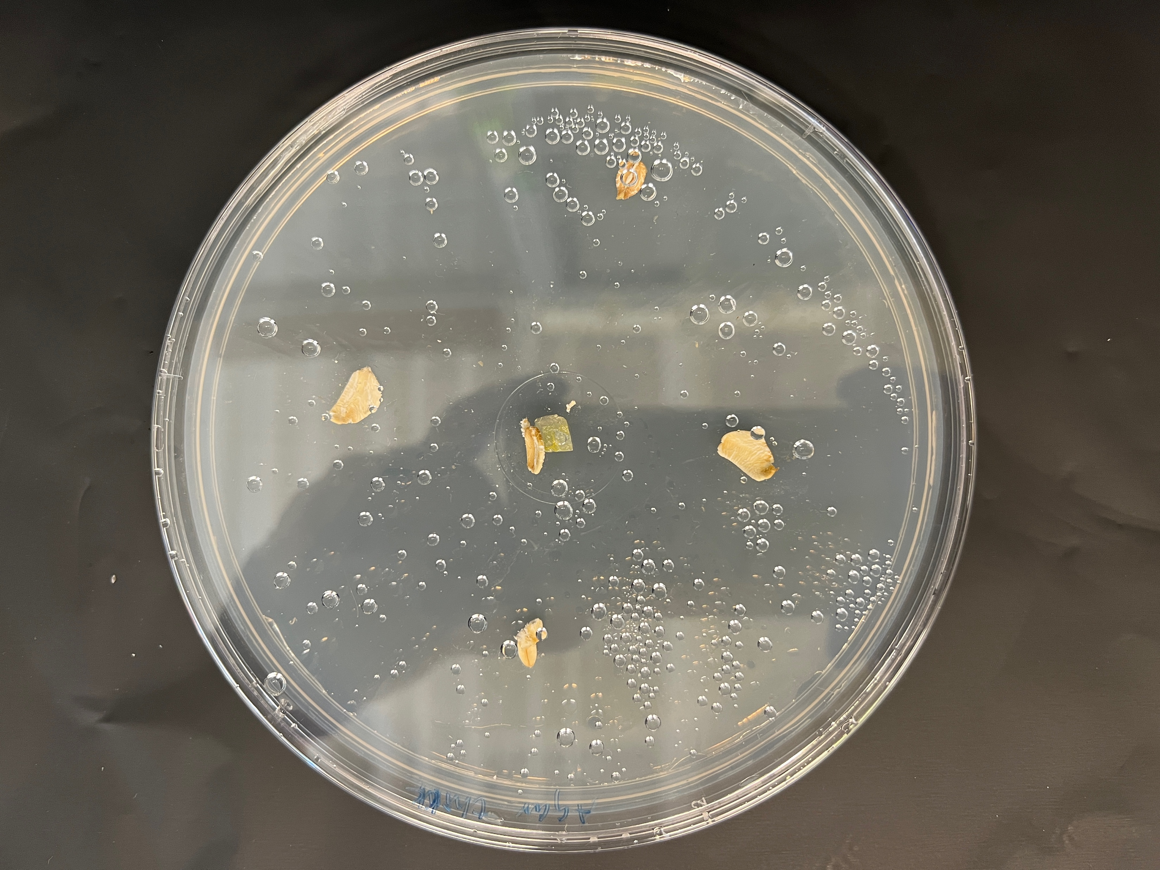
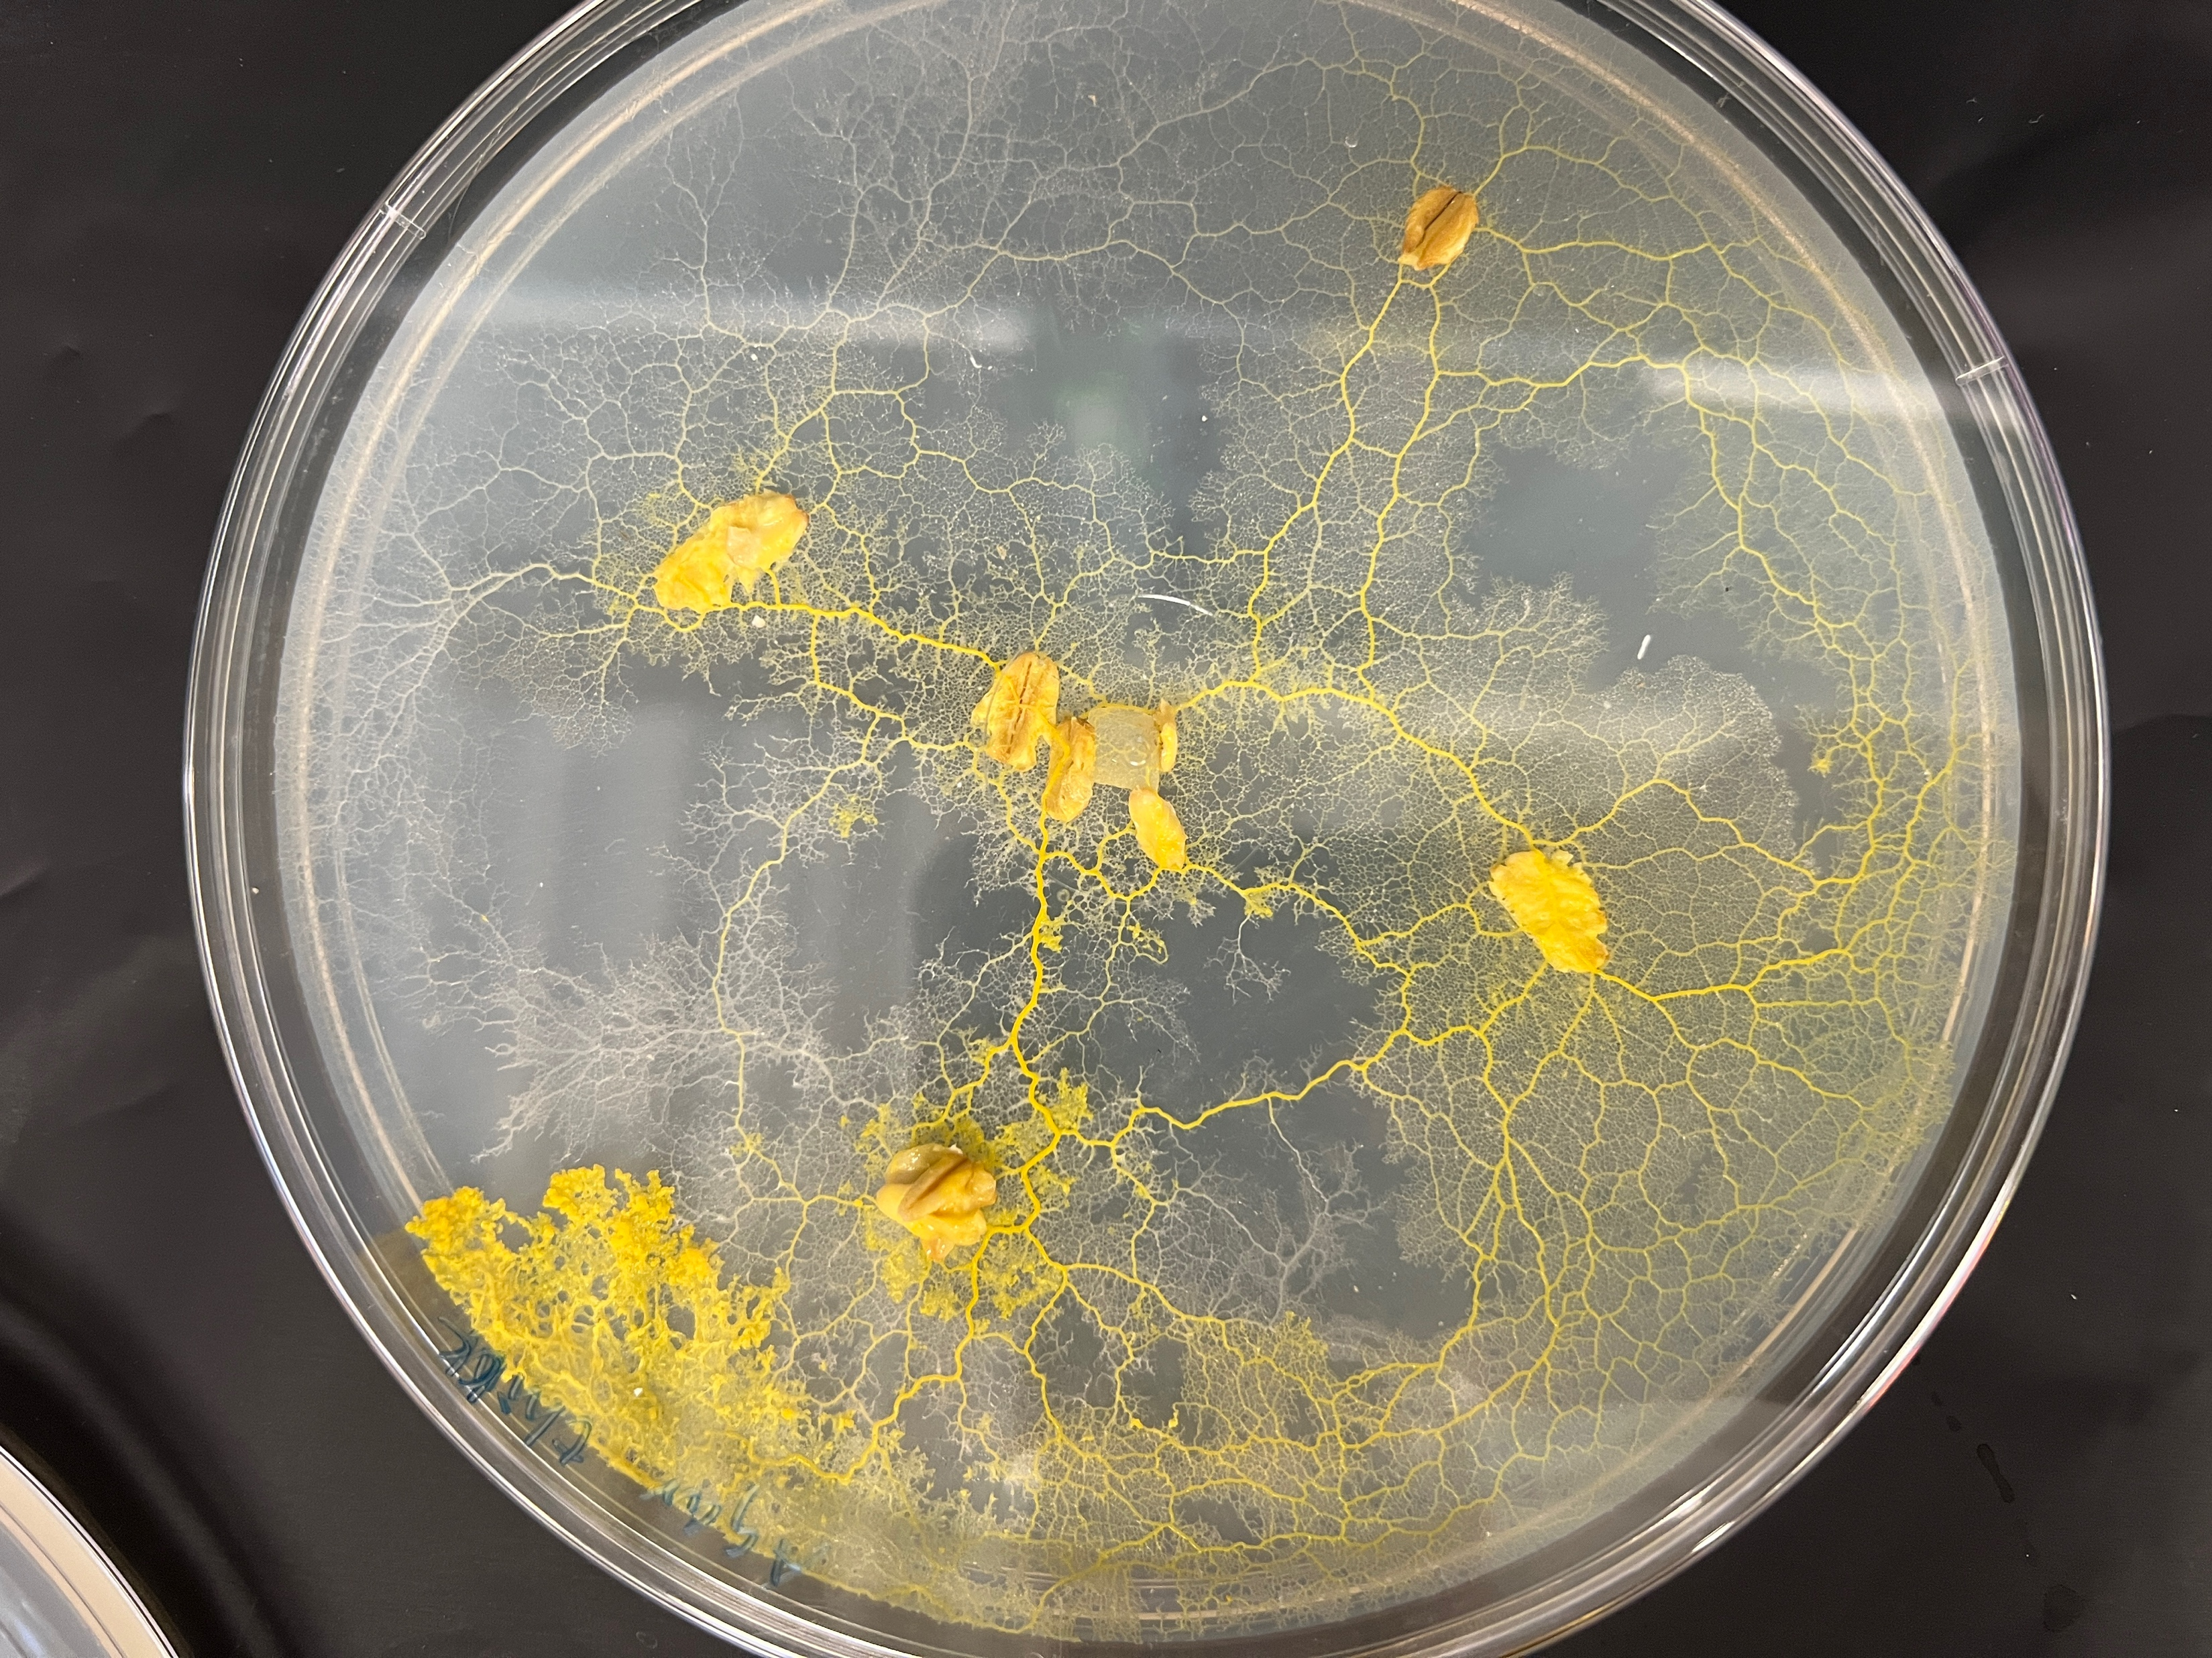
Agent-based simulation

Slide 2
Agent-based simulation

Slide 3
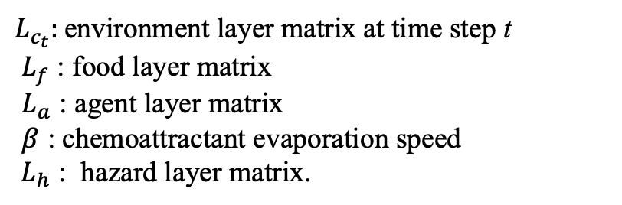
Agent-based simulation
$$L_{c_{t+1}}=\min\left(\left(L_{c_{t}}+L_{f}+L_{a}\right)∗β, { L}_{h}\right)$$
$L_{c_{t}}:$environment layer matrix at time step t
$L_{f}$ : food layer matrix
$L_{a}$ : agent layer matrix
$β$ : chemoattractant evaporation speed
${ L}_{h}$ : hazard layer matrix.

Slide 4
A 3x3 diffusion filter is used to mimic the diffusion process of the chemoattractant at each time step
The agent movement sequence is shuffled at each simulation time step
The agent cannot move to a pixel if the pixel is out of boundary (the circle) or another agent exists at that pixel
When an agent cannot make a successful movement, it will randomly choose a new moving direction.

Slide 5
Agent-based simulation

Slide 6
Evolving process without hazard

Slide 7
Network adaptive to a persistent hazard

Slide 8
Network adaptive to a gradually mitigating hazard

